Slide 1
Adult Perspective Shift
in the Wisconsin School Mental Health Framework
Adapted from the the work of Ross Green
Notes:
A foundational question to explore for yourself and with your colleagues is: What do you believe about human behavior? These few slides introduce the work of Ross Greene and others who promote the philosophy that humans do well when they can.

Slide 2
What is your philosophy?
or
External Motivation
Abilities and Supports
Notes:
When you are working with kids, especially kids with challenges, you need a philosophy.
When curious, you ask questions: “Who is this kid?” “What is he or she up to?”
Your philosophy will guide your actions, especially when the challenges are acute. Without a philosophy, you don’t have a guide as to what to do.
The philosophy driving this work is “Kids do well if they can.” This contrasts to the much more popular philosophy that “Kids do well if they want to.”
There are completely different philosophies, and have completely different ramifications for what you are going to do to help make things better.
If you have a “Kids do well if they want to” philosophy, then you would believe that a kid who isn’t doing well, is having that problem because he or she doesn’t want to.
Watch this next video with Ross Greene speaking about these two philosophies. Consider whether you are ready for a perspective shift in this area? If you are curious about this, the link on the top of the page will take you to Ross Greene’s work.

Slide 3
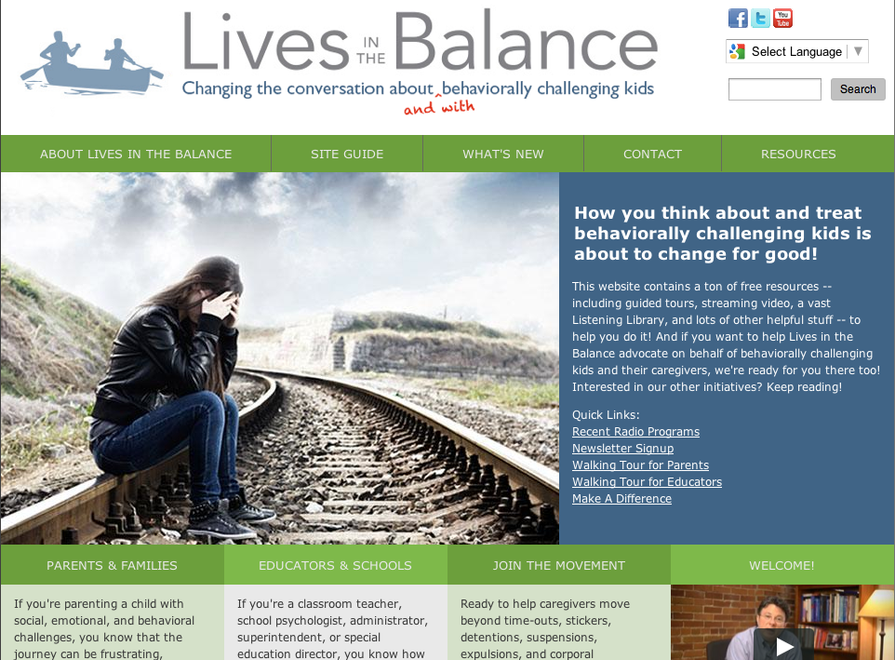
Ross Greene
Notes:
This website includes a short video and a guide on how to engage students and families with social, emotional and behavioral challenges. It digs into this adult attitude shift and provides many resources for future professional development. Let’s listen as Ross Greene explains the difference between the belief that a child does well if they want to versus if they can.
Reach the 4 ½ minute video by clicking on the webpage image.

Slide 4
Adult Perspective Shift
Kids do well if they want to …
Manipulative and control-seeking
Attention-seeking
Not motivated
Limit testing
Kids do well if they can …
Behavior as communication
Coping in the way they have learned
Skill deficits
Together we can figure it out
Notes:
The two very different mindsets are on this slide.
Below them are words that we might hear used to describe a child’s behavior or motivation. The first four fit with the belief that kids would do well if they just wanted to. The last four fit with the belief that kids would do well if they can.

Slide 5
Reflection
What are the assumptions, interventions, and outcomes that arise with “kids do well when they can” versus
“kids do well when they want to?”
Notes:
How these mindsets impact us and the children we serve?
Some key concepts for the role of an educator who believes that kids do well if they can include:
Practice effective educational strategies.
Spotlight unusual challenges based on developmental norms for age you teach.
Be curious, consistently work to connect, and co-plan with students and parents.
Offer realistic hope and authentic caring.
Connect to informal and formal supports.
Educators who believe that it is mostly a matter of motivation – “Kids need to want to do better” – may find themselves fatigued from trying to motivate with the carrot or stick when what is needed is collaborative problem solving and skill development. One’s basic philosophy about behavior can be a big cause of compassion fatigue.

Slide 6
Adult Perspective Shift - Colleagues
Educators do well if they want to?
Educators do well if they can?
Notes:
This applies to how we think about staff and colleague behavior too!

Slide 7
Adult Perspective Shift - Parents
Parents engage if they want to?
Parents engage if they can?
Notes:
And, of course, it is also applied to how we think about parents’ behavior. How are parents discussed in your school? Do you ever hear negative talk about parents’ being “checked out” and unwilling to support their student’s success at school? When parents arrive, do we trust that they have a unique perspective to offer and are willing to share with us strategies that engage their child? Do we value home/school collaboration where a coordinated approach among the adults is the ultimate goal? How do we handle the distress of parents who are deeply worried about their child, and may appear defensive or blaming? Do we see helpful parenting as a matter of motivation or skill and supports?

