Slide 1
Provider Perspective Shift
Foundational Beliefs about Behavior
Developed in partnership with:
Notes:
A foundational question to explore for yourself and with your colleagues is: What do you believe about human behavior? These few slides introduce the philosophy that humans do well when they can.

Slide 2
What is your philosophy?
or
Motivation?
Ability?
Notes:
When you are working with clients, you need a philosophy.
When curious, you ask questions: “Who is this person?” “What is he or she up to?”
Your philosophy will guide your actions, especially when the challenges are acute. Without a philosophy, you don’t have a guide as to what to do.
The philosophy driving this work is “People do well if they can.” This contrasts to the much more popular philosophy that “People do well if they want to.”
They are completely different philosophies, and have completely different ramifications for what you are going to do to help make things better.
If you have a “People do well if they want to” philosophy, then you would believe that a person (or client) who isn’t doing well, is having that problem because he or she doesn’t want to. This makes coming from a place of empathy and compassion and can contribute to compassion fatigue.
Consider whether you are ready for a perspective shift in this area?

Slide 3
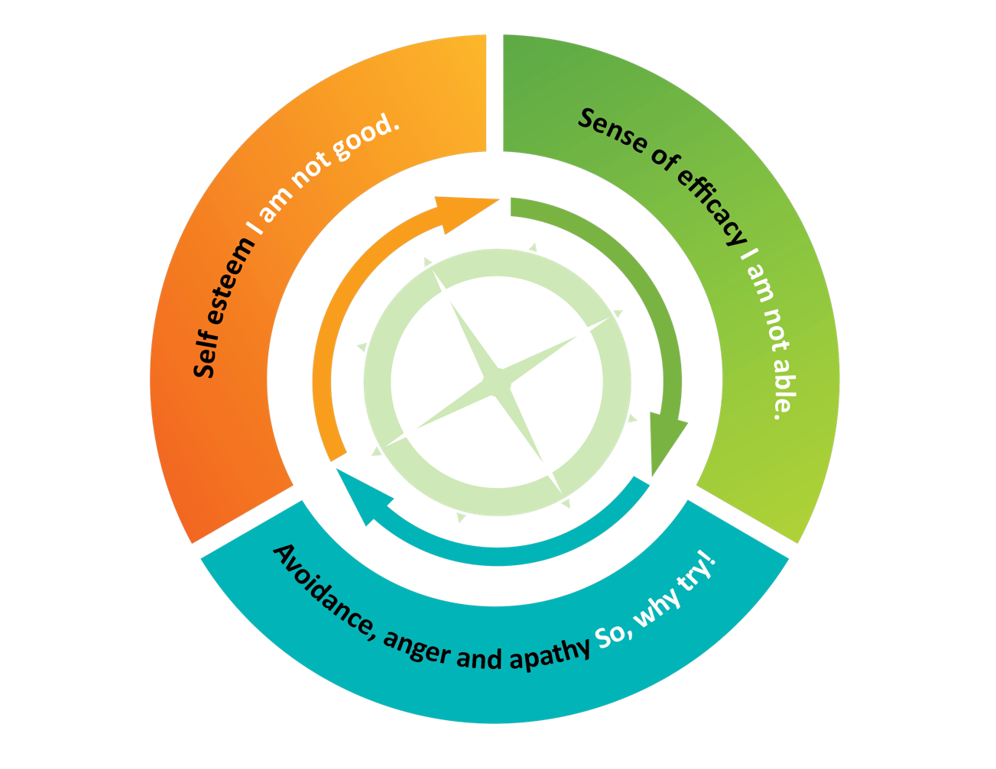
“If I really wanted to do something, I would be able to.”
Feelings of Shame
Notes:
Whether it is a client, a colleague or yourself, if your primary belief about behavior is based in motivation- when you cannot meet an expectation you would begin to see yourself as not…
What in our family, work, community and national culture supports this belief?

Slide 4
Provider Perspective Shift
People do well if they want to …
Manipulative and control-seeking
Attention-seeking
Not motivated
Limit testing
People do well if they can …
Behavior as communication
Coping in the way they have learned
Skill deficits
Together we can figure it out
Notes:
The two very different mindsets (want to versus can) are on this slide.
Below them are words that we might hear used to describe a client’s behavior or motivation. The first four fit with the belief that people would do well if they just wanted to. The last four fit with the belief that people would do well if they can.

Slide 5
Reflection
What are the assumptions, interventions, and outcomes that arise with “kids do well when they can” versus
“kids do well when they want to?”
Notes:
How these mindsets impact us and the clients we serve?
Some key concepts for the role of a provider who believes that our clients do well if they can include:
Practice effective caregiving strategies.
Be curious, consistently work to connect, and co-plan with clients and their families.
Offer realistic hope and authentic caring.
Connect to informal and formal supports.
Providers who believe that it is mostly a matter of motivation – “My clients need to want to do better” – may find themselves fatigued from trying to motivate with the carrot or stick when what is needed is collaborative problem solving and skill development. Again, one’s basic philosophy about behavior can be a big cause of compassion fatigue.

Slide 6
Perspective Shift - Colleagues
Providers do well if they want to?
Providers do well if they can?
Notes:
This applies to how we think about staff and colleague behavior too!

Slide 7
Perspective Shift - Families
Families engage if they want to?
Families engage if they can?
Notes:
And, of course, it is also applied to how we think about the behavior of clients’ families and other caregivers. How are families discussed in your organization? Do you ever hear negative talk about families’ being unwilling to support their family member’s well-being or are contributing to poor health? When families are there, do we trust that they have a unique perspective to offer and are willing to share with us strategies that engage their family member? Do we value collaboration where a coordinated approach among the provider, client and family is the ultimate goal? How do we handle the distress of families who are deeply worried about their family member, and may appear defensive or blaming? Do we see helpful families as a matter of motivation or skill and supports?

Slide 8
Stages of Chane Theory – what’s needed for change?
Insight
Realistic and relevant hope
Understanding one’s good reasons for unhelpful behavior
Time to let go
Planning and practice (learn what motivates)
Avoidance of triggers
Gradual exposure to triggers
Support for maintenance that includes plan for “refresh”
Prochaska and DiClementi
Notes:
Consider whether you are ready to change your perspective/philosophy
So, if simply wanting to change doesn’t work, what do we know about change? The stage of change theory, which is the foundation of motivational interviewing, would suggest that successful change is a matter of gaining specific supports and abilities that are matched to the readiness of each unfolding stage. It is the growing sense of hope and sense of efficacy that serves as the motivator rather than external motivators as the spark for one to succeed. And, whether we are educators or psychiatrists, we seek to connect with people and walk along side them as they move towards positive change- offering supports and skill building.

